Slide 1

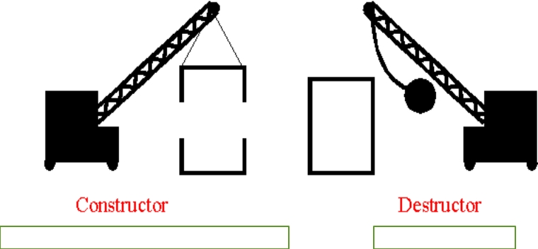
CONSTRUCTORS AND DESTRUCTORS

Slide 2
Contents
▪ Constructors
▪ Types of Constructors
▪ Constructor Overloading
▪ Default arguments to Constructor ▪ Destructor
By: Kanika Sharma
2

Slide 3
Constructor
▪ Constructors are the special type of member function that initializes the object automatically when it is created.
▪ The Compiler calls the Constructor whenever an object is created.
▪ Constructors initialize values to object members after storage is allocated to the object.
▪ They are having the same name as a class name. ▪ They do not have any return type.
By: Kanika Sharma
3

Slide 4






Types of constructors
Constructor
Default
Parameterized
Copy
By: Kanika Sharma
4

Slide 5
Default constructor
▪ A default constructor is a constructor which can be called with no arguments.
▪ If no user-declared constructors in program, the compiler will always declare a default constructor as an inline public member of its class.
▪ Syntax: class_name () { Constructor Definition }
By: Kanika Sharma
5

Slide 6
Parameterized Constructor
▪ These are the constructors with parameter. ▪ Using this Constructor you can provide
different values to data members of different objects, by passing the appropriate values as argument.
By: Kanika Sharma
6

Slide 7
Copy constructor
▪ These are special type of Constructors which takes an object as argument, and is used to copy values of data members of one object into other object.
By: Kanika Sharma
7

Slide 8
Dynamic Constructor
▪ Dynamic constructor is used to allocate the memory to the objects at the run time.
▪ Memory is allocated at run time with the help of 'new' operator.
▪ By using this constructor, we can dynamically initialize the objects.
By: Kanika Sharma
8

Slide 9
Constructor Overloading
▪ Constructors can also be overloaded. Infect when you have both default and parameterized constructors defined in your class you are having Overloaded Constructors, one with no parameter and other with parameter.
▪ You can have any number of Constructors in a class that differ in parameter list.
By: Kanika Sharma
9

Slide 10
Program on the concept of
#includeconstructor<iostream>
operations(operations &p) //Copy Constructor
{
using namespace std;
a=p.a;
b=p.b;
class operations
}
{
int *c;
operations(int q) //Dynamic Construcotr
int a,b,mul,div,sum,sub;
{
public:
c=new int;
operations() //Default Constructor
*c=q;
{
a=10;
b=20;
}
}
operations(int x,int y) //Parameterized Constructor {
a=x;
b=y;
}
By: Kanika Sharma
10

Slide 11
void display()
int main()
{
{
cout<<"Value of a variable is"<<*c<<endl; }
cout << "\t\t1.Calling Default Constructor" << endl;
operations op1;
void add()
op1.add();
{
cout << "\t\t2.Calling Perameterized
sum=a+b;
Constructor" << endl;
cout<<"sum is"<<sum<<endl;
operations op2(100,50);
}
op2.subt();
cout << "\t\t3.Calling Dynamic Constructor" << endl;
void subt()
{
operations op4(100);
sub=a-b;
op4.display();
cout<<"subtraction is"<<sub<<endl;
cout << "\t\t4.Calling Copy Constructor" << endl;
}
void mult()
operations op3=op2;
{
op3.mult();
mul=a*b;
cout<<"Multiphication is"<<mul<<endl;
return 0;
}
}
By: Kanika Sharma
11

Slide 12
Destructor
▪
Destructor is a special class function which destroys the object as soon as the scope of object ends. The destructor is called automatically by the compiler when the object goes out of scope.
▪
Destructor don not have argumetns Destructor can not be overloaded
▪
▪
The syntax for destructor is same as that for the constructor, the class name is used for the name of destructor, with a tilde ~ sign as prefix to it.
By: Kanika Sharma
12

Slide 13
Properties of Constructors &
Destructor
▪
Constructor and destructor can not be inherited although they can be call in derived class. Destructor can be virtual but constructor can not be.
▪
▪
We can not access the address of constructor and destructor.
▪
Constructor and destructor can make implicit call to operator new and delete if memory allocation and de-allocation is required for and object.
By: Kanika Sharma
13

Slide 14
Let us revise
▪ By default the return type of constructor is__. (a) Int
(b)Float
(c) Char
(d) No return type
By: Kanika Sharma
14

Slide 15
▪ Default Constructor have __ number of arguments.
(a)2
(b)3
(c)1
(d) 0
By: Kanika Sharma
15

Slide 16
▪ If default constructor is not defined, then how the objects of the class will be created? a. The compiler will generate error
▪ b. Error will occur at run-time.
▪ c. Compiler provides its default constructor to build the object.
▪ d. None of these
By: Kanika Sharma
16

Slide 17
▪ What happens when a class with parameterized constructors and having no default constructor is used in a program and we create an object that needs a zero- argument constructor?
A.Compile-time error.
B.Preprocessing error.
C.Runtime error.
D.Runtime exception.
By: Kanika Sharma
17

Slide 18
▪ Can a class have virtual destructor? ▪ A.Yes
▪ B.No
By: Kanika Sharma
18

Slide 19
▪ Destructor has the same name as the constructor and it is preceded by ______ .
▪ A.!
▪ B.?
▪ C.~
▪ D.$
By: Kanika Sharma
19

Slide 20
▪ Which constructor function is designed to copy objects of the same class type?
▪ A.Create constructor
▪ B.Object constructor
▪ C.Dynamic constructor
▪ D.Copy constructor
By: Kanika Sharma
20

Slide 21
▪ Copy constructor must receive its arguments by __________ .
▪ A.either pass-by-value or pass-by-reference ▪ B.only pass-by-value
▪ C.only pass-by-reference
▪ D.only pass by address
By: Kanika Sharma
21

